Slide 1
Config Management:
Ansible
@NoahJS
Noah Spirakus

Slide 2
[…] Ansible has the lowest learning curve of all the CM tools, so if you found this chapter at all challenging, you should use Ansible and not even consider the other tools.
Matt Jaynes
[ Taste Test ]

Slide 3
Infrastructure as Code

Slide 4
We want to move from:
$ ssh web1
$ yum update
$ yum install httpd
$ rpm -Uvh http://mirror.webtatic.com/yum/el6/latest.rpm
$ yum install php55w, php55w-common, php55w-devel, php55w-cli, php55w-gd, php55w-mcrypt, php55w-mbstring,
php55w-mysql, php55w-pecl-memcache, php55w-opcache, php55w-process, php55w-xml
$ curl -sS https://getcomposer.org/installer | php -- --install-dir=/usr/local/bin
$ mv /usr/local/bin/composer.phar /usr/local/bin/composer
$ vim /etc/conf.d/httpd.conf
# Make sure configs are correct
$ vim /etc/php
# Change logging, configs, error reporting, timezone etc…
$ service httpd restart
$ chkconfig httpd
$ ssh web2
$ yum update
$ yum install httpd
$ rpm -Uvh http://mirror.webtatic.com/yum/el6/latest.rpm
…

Slide 5
To:
$ bash “Make me a webserver”

Slide 6
To: (Even better)
$ bash “Make me a webserver like last time”

Slide 7


Solution
Configuration Management
*
*Maybe slightly over exaggerated

Slide 8






The Options

Slide 9
Timeline

Slide 10
Comparison
Configs
Configs + Execution

Slide 11

Lets build a LAMP

Slide 12
LAMP: Bash
$ ssh web1
$ yum -y update
$ yum -y install httpd
$ rpm -Uvh http://mirror.webtatic.com/yum/el6/latest.rpm
$ yum install php55w, php55w-common, php55w-devel, php55w-cli, php55w-gd, php55w-mcrypt, php55w-mbstring,
php55w-mysql, php55w-pecl-memcache, php55w-opcache, php55w-process, php55w-xml
$ curl -sS https://getcomposer.org/installer | php -- --install-dir=/usr/local/bin
$ mv /usr/local/bin/composer.phar /usr/local/bin/composer
$ vim /etc/conf.d/httpd.conf
# Make sure configs are correct
$ vim /etc/php
# Change logging, configs, error reporting, timezone etc…
$ service httpd restart
$ chkconfig httpd

Slide 13
LAMP: Puppet

Slide 14
LAMP: Puppet (Layout)

Slide 15
LAMP: Puppet (Terminology)
Directives = Resources
Directives Script = Manifest
Facter is the utility Puppet uses for detecting node metadata.

Slide 16
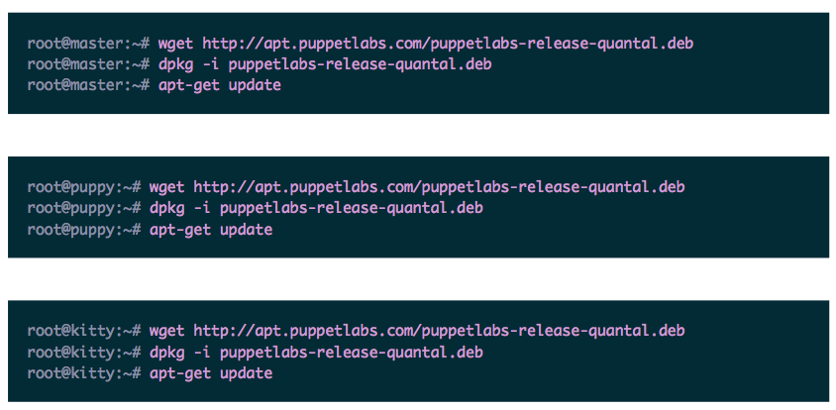
LAMP: Puppet
1. Install Puppet on all nodes

Slide 17
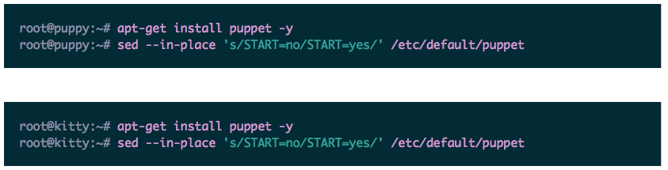
LAMP: Puppet
2. Setup Puppet clients on the children nodes to automatically start on reboots:

Slide 18
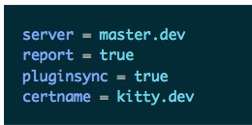
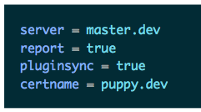
LAMP: Puppet
3. Add settings to the children nodes in the [main] section of
/etc/puppet/puppet.conf

Slide 19
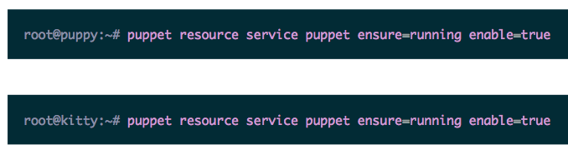
LAMP: Puppet
4. Start & Enable Puppet clients

Slide 20
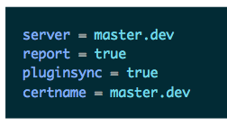
LAMP: Puppet
5. Setup Master node
- root@master:~# apt-get install puppetmaster -y
- Add to /etc/puppet/puppet.conf
- root@master:~# puppet resource service puppetmaster ensure=running enable=true

Slide 21
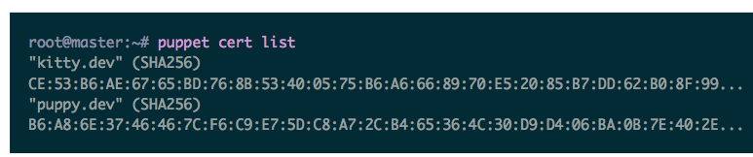
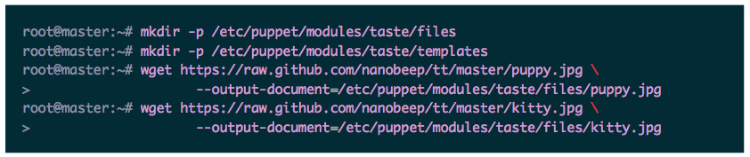
LAMP: Puppet
5. Setup Master node (cont)
- Sign Client certificates
- root@master:~# puppet cert sign –all
- Add supporting files

Slide 22
LAMP: Puppet
Puppet Files:
/etc/puppet/modules/taste/templates/index.erb
/etc/puppet/manifests/site.pp
REF:
https://github.com/noahjs/azphp-configmanagement-presentation/example-code/puppet

Slide 23
LAMP: Puppet (Notes)
Directive Language: Custom
Execution Order:
Custom internal ordering for directives
Remote execution: N/A
Recommends: mcollective

Slide 24
LAMP: Chef

Slide 25
LAMP: Chef (Layout)

Slide 26
LAMP: Chef (Terminology)
^{Directives = Resources}
^{Directives Script = Recipe}
Group of recipes and supporting files = Cookbook
Ohai is the utility Chef uses for detecting node metadata.

Slide 27
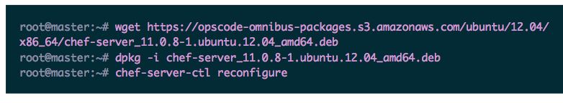
LAMP: Chef
1. Install Chef on Master

Slide 28
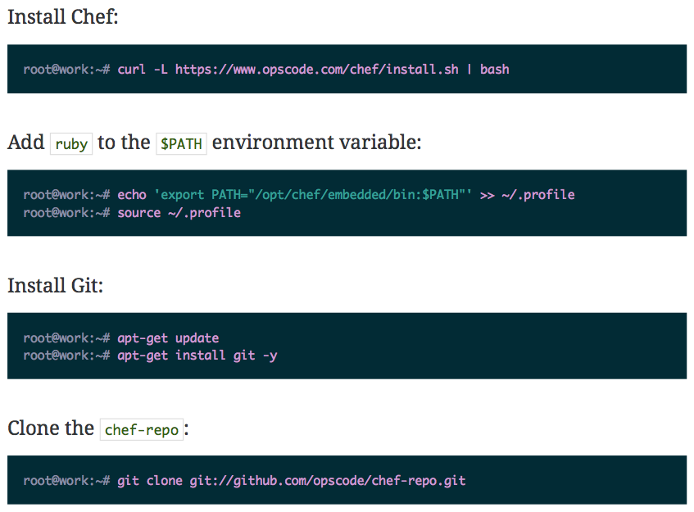
LAMP: Chef
2. Install Chef on Workstation

Slide 29
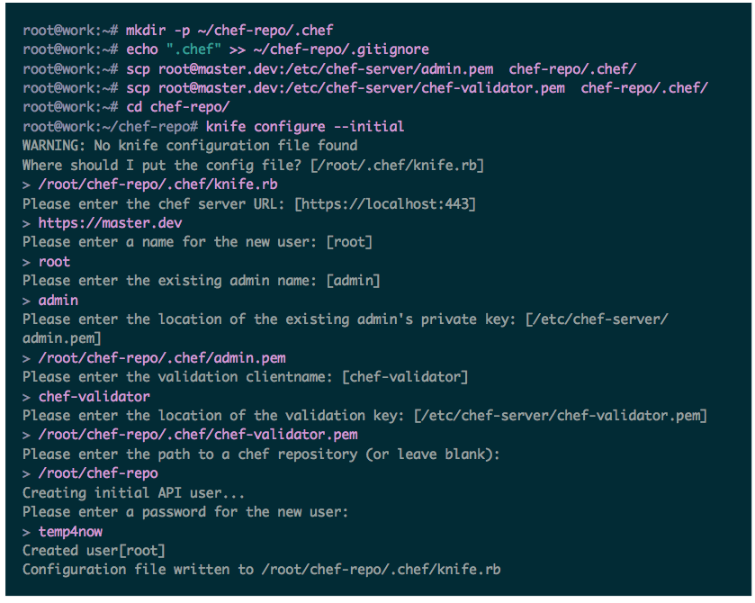
LAMP: Chef
3. Set up the configuration files

Slide 30
LAMP: Chef
4. Install Chef on Children
root@work:~/chef-repo# knife bootstrap puppy.dev -x root
root@work:~/chef-repo# knife bootstrap kitty.dev -x root
That was pretty easy no?

Slide 31
LAMP: Chef
5. Create Cookbook
root@work:~/chef-repo# knife cookbook create taste
Chef Cookbook Files:
/root/chef-repo/cookbooks/taste/templates/default/index.html.erb
/root/chef-repo/cookbooks/taste/recipes/default.rb
REF:
https://github.com/noahjs/azphp-configmanagement-presentation/example-code/chef

Slide 32
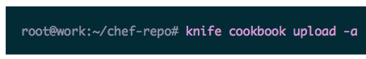
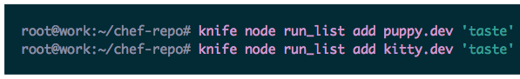
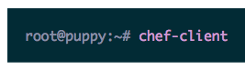
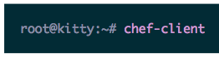
LAMP: Chef
6. Upload the directives and supporting files to the master
7. Add the directives to the children nodes’ “run list”
8. Run the directives on the children
It’s not necessary to do this manually, but we do this since we don’t want to wait the 30 minutes for it to run automatically.

Slide 33
LAMP: Chef (Notes)
Requires Master w/ 1GB RAM, will fail on 512MB RAM.
Execution Order: Sequential
Files: Ruby with an extended DSL

Slide 34
LAMP: Saltstack

Slide 35
LAMP: Saltstack (Layout)

Slide 36
LAMP: Saltstack (Notes)
Directives = States
Directives Script = SLS Formula (SLS stands for SaLt State)
Children Nodes = Minions
Node metadata = Grains
Pillar = interface used to generate arbitrary data for specific minions

Slide 37
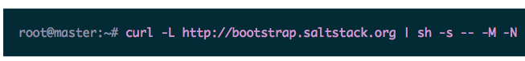
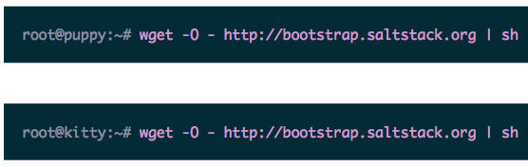
LAMP: Saltstack
1. Install Salt on Master
2. Install Salt on Children

Slide 38
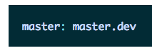
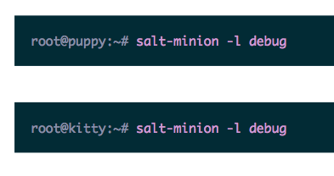
LAMP: Saltstack
3. On child node: Edit /etc/salt/minion
3b. Test children

Slide 39
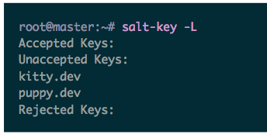
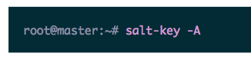
LAMP: Saltstack
4. Check certificate requests
5. Accept requests

Slide 40
LAMP: Saltstack
6. Create Directives
root@master:~# mkdir /srv/salt
root@master:~# touch /srv/salt/taste.sls
root@master:~# touch /srv/salt/index.html
Saltstack Directive Files:
/srv/salt/taste.sls
/srv/salt/index.html
REF:
https://github.com/noahjs/azphp-configmanagement-presentation/example-code/salt

Slide 41
LAMP: Saltstack (Notes)
Execution Order: Sequential
Files: YAML and Jinja2
Runs on ZeroMQ socket between all nodes
Remote execution is standard and robust with Salt

Slide 42
Saltstack: Remote Execution
￼root@master:~# salt '*' cmd.run 'date’
puppy.dev:
Tue Aug 6 08:33:45 UTC 2013
kitty.dev:
Tue Aug 6 08:33:45 UTC 2013

Slide 43
LAMP: Ansible

Slide 44
LAMP: Ansible (Layout)

Slide 45
LAMP: Ansible (Notes)
Directives = Tasks
Directives Script = Playbook
Children Nodes = Hosts

Slide 46
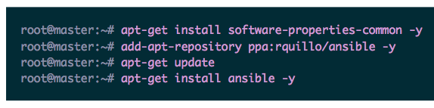
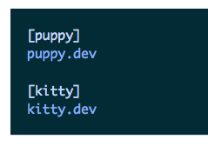
LAMP: Ansible
1. Install Salt on Master
2. Tell Master about children, Edit: /etc/ansible/hosts

Slide 47
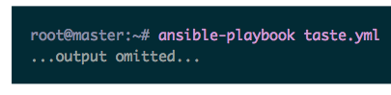
LAMP: Ansible
3. Make sure Master ssh key exists on clients
4. Write Playbook
- /root/playbook.yml
5. Run:
REF:
https://github.com/noahjs/azphp-configmanagement-presentation/example-code/ansible

Slide 48
LAMP: Ansible (Notes)
Execution Order: Sequential
Files: YAML and Jinja2
Remote execution runs across SSH

Slide 49
Ansible: Remote Execution
root@master:~# ansible all –m
command -a "date”
kitty.dev | success | rc=0 >>
Tue Aug 6 06:23:47 UTC 2013
puppy.dev | success | rc=0 >>
Tue Aug 6 06:23:47 UTC 2013

Slide 50
Full Ansible Demonstration
REF:
https://github.com/noahjs/azphp-configmanagement-presentation/full-ansible-example
Requirements:
Install Ansible
Run “vagrant up” from that directory

